Slide 1
ADL2022 HW3 report
R09922126 黃宇瑍

Slide 2
Q1: Model
mt5-small is a transformer encoder-decoder created by Google.
The input of it is the t5-tokenized text sequence. And after go through the entire transformer , it will produce a logits distribution. Then, they will pass through the softmax layer and produce a probability distribution(or confidence scores). We can use any sample method to construct a sentence based on the distribution.

Slide 3
Q1: Model
Preprocessing:
Tokenization: t5 tokenizer is sentencepiece based, which is compose of byte-pair-encoding and unigram-language-model. It will cut sentence into subwords and use Viterbi-algorithm to find the highest probability path to tokenize.

Slide 4
Q2: Training
Hyperparameter:
Epochs: 12
batch size: 16
Warmup ratio: 0.1
Weight decay: 0.1
The epochs and batch size are random choosed. Warmup ratio can prevent fast convergence to a local minimum. Weight decay can reduce overfitting situation.

Slide 5
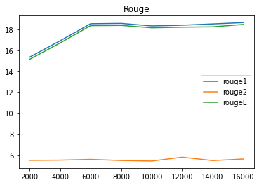
Q2: Training
Learning Curves(caculate by load_metric(“rouge”)):

Slide 6
Q3: Generation Strategies
Stratgies:
Greedy: This method will choose the token(word) with highest probability at every time step.
Beam Search: With a beam size, for example , 3, in every time step, it will choose the top 3 tokens(words) as candidates. Then, it will multiplies the probability of it with all previous tokens as a score and stores them. So, in the first time step, it will have 3 candidates, after that, it will have 9(3x3) candidates and preserve the top 3 candidates(base on the score) until the last time step. In the last time step, it will choose the highest score one as the final result.

Slide 7
Q3: Generation Strategies
Stratgies:
Top-k Sampling: In every time step, it only preserves the top k probability tokens as candidates, and sample a token(word) from them.
Top-p Sampling: In every time step, it only preserves the tokens(words) with probability higher than p, and sample a token from them.
Temperature: Before the softmax layer, the output logits will be divide by T(Temperature). Then it will go through the softmax layer and output a probability. After that, we do greedy sampling.

Slide 8
Q3: Generation Strategies
Hyperparameters:
I tried several methods.
We can see, beam seach is
performed all other methods.
And greedy is very similar to top-p
with p = 0.9.
Finnaly, I choose beam search with
size 15 as final result.
 | greedy | Beam3 | Beam5 | beam15 | Top-p 0.9
Rouge1-r | 0.2875 | 0.3058 | 0.3085 | - | 0.2875
Rouge1-p | 0.1913 | 0.2030 | 0.2086 | 0.2141 | 0.1913
Rouge1-f | 0.2237 | 0.2373 | 0.2421 | 0.2462 | 0.2237
Rouge2-r | 0.1016 | 0.1124 | 0.1149 | 0.1163 | 0.1016
Rouge2-p | 0.0588 | 0.0666 | 0.0697 | 0.0724 | 0.0588
Rouge2-f | 0.0725 | 0.0813 | 0.0844 | 0.0869 | 0.0725
RougeL-r | 0.2511 | 0.2670 | 0.2693 | 0.2705 | 0.2511
RougeL-p | 0.1661 | 0.1762 | 0.1812 | 0.1864 | 0.1661
RougeL-f | 0.1946 | 0.2064 | 0.2106 | 0.2145 | 0.1947

Slide 9
Bonus: Applied RL on Summarization
Algorithm:
I use classical policy gradient as the RL algorithm. For every generated sentence, I assign the same reward to every single token(word). The reward functions I tried are rouge-1 and rouge-L. Each reward function make the model more robust for the model.
Compare to Supervised Learning:
The most significant difference is that, in the RL methods bellow, they all need only one epoch to pass the baseline. But supervised learning method needs 5 or more epochs to pass it.

Slide 10
Bonus: Applied RL on Summarization
(RL methods are all producing sentence in greedy way.)
As we can see, with RL algo. the scores can improved dramatically.
Most importantly, RL methods only needs 1 epoch to pass the base line.
And rouge-1 performs more robust than rouge-L.
 | Beam search 15 (12 epochs) | Reward: rouge-1 (1 epoch) | Reward: rouge-L (1 epoch)
Rouge1-r | - | 0.2569 | 0.2434
Rouge1-p | 0.2141 | 0.3002 | 0.2881
Rouge1-f | 0.2462 | 0.2747 | 0.2618
Rouge2-r | 0.1163 | 0.0948 | 0.0866
Rouge2-p | 0.0724 | 0.1038 | 0.0959
Rouge2-f | 0.0869 | 0.0983 | 0.0903
RougeL-r | 0.2705 | 0.2464 | 0.2331
RougeL-p | 0.1864 | 0.2875 | 0.2754
RougeL-f | 0.2145 | 0.2633 | 0.2506

Slide 11
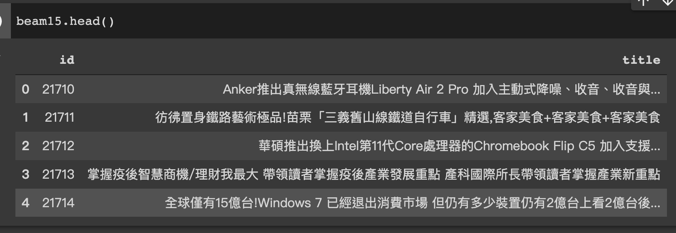
Bonus: Applied RL on Summarization
Text generation comparation:
Beam search size 15

Slide 12
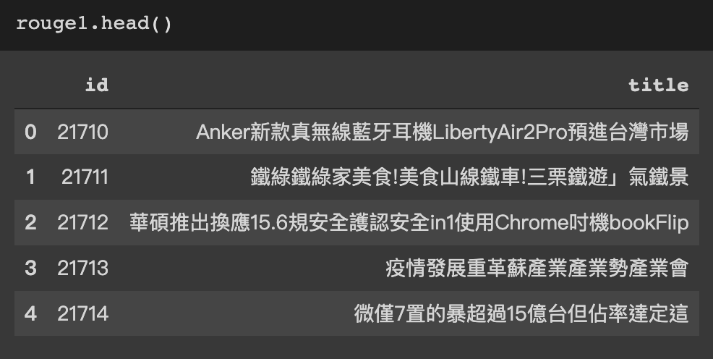
Bonus: Applied RL on Summarization
Text generation comparation:
Rouge1 greedy

Slide 13
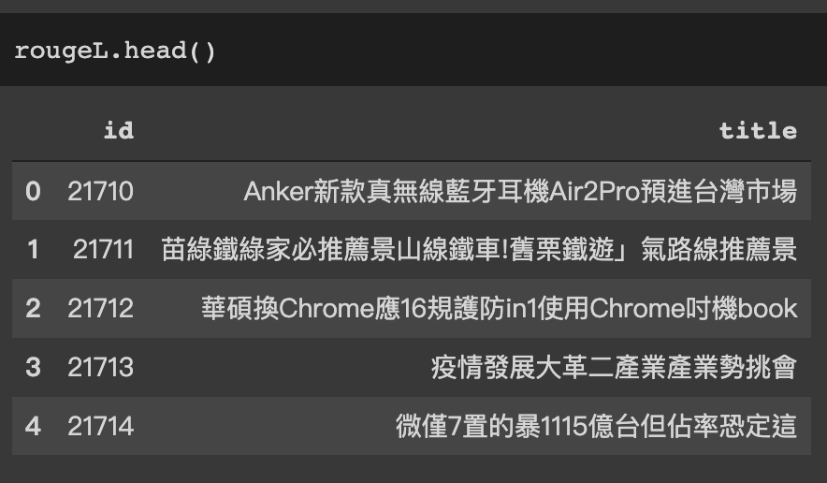
Bonus: Applied RL on Summarization
Text generation comparation:
RougeL greedy

Slide 14
Bonus: Applied RL on Summarization
Text generation comparation: As we can see in the previous examples. The fluency of supervised learning is greater than rouge RL based methods. But still, RL methods gets the higher scores.
So we can tell, RL methods may lead to overfit on reward function. Which makes sense that it gets the higher score but outputs a lot of trashes. So we may need to fine tune the weight of reward to prevent overfitting, or even introduce dynamic weighted reward.
e.g. In the beginning , the weight is very low. And it keeps going up until the end of the training.

